Slide 1

Task 1I UNIVERSITY OF BUEA Faculty Of Engineering and Technology
Internet Programming And Mobile Programming – CEF 440
By Dr. Nkemeni Valery
Group 16

Slide 2
Agenda
02
03
01
INTRODUCTION
STAKEHOLDER IDENTIFICATION
REQUIREMENT GATHERINE TECHNIQUE
Brief intro into phase2 of the SDLC
Various stakeholders involved in the system
Comparing the 3 primary types of mobile applications.
04
DATA GATHERING
Review And Comparison of Mobile Application
DATA CLEANING
05
06
USER RELUCTANCE
07
CONCLUSION
Review on how the data gathered was cleansed.
Introduction to budgeting tools and apps.
General Summary

Slide 3

INTRODUCTION
01
This presentation explores the requirement gathering phase of the SDLC.

Slide 4
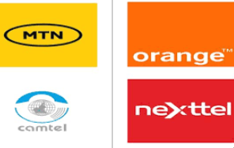
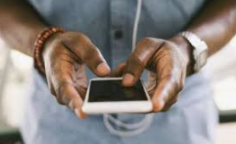

STAKEHOLDERS IDENTIFICATION 1/2
02
PRIMARY STAKEHOLDERS
Mobile Network Operators
Mobile Subscriber
- Development Team
These are the individuals responsible for designing, building and testing the system.
The main beneficiaries of this system since they will use it to optimize their network.
Their role is to provide raw data. They benefit from potentially better network performance.

Slide 5
STAKEHOLDERS IDENTIFICATION 2/2
SECONDARY STAKEHOLDERS
Telecommunication Regulatory Authorities eg: TRB in Cameroon
Network Engineers and Optimization teams
They have interest in using such data to ensure MNOs are meeting their SLA and QoS
They will analyze the data to pinpoint specific geographical areas with poor performance
Data Privacy and Compliance officers

Slide 6
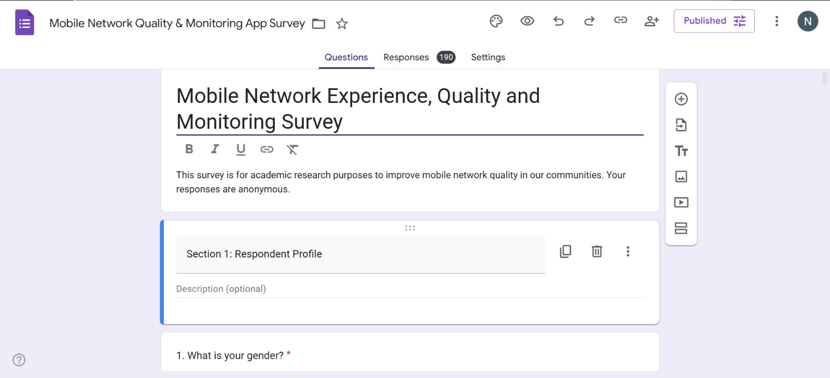
Requirement gathering technique 1/3
03
SURVEY
Administered to mobile subscribers across Cameroon.
Distributed as google forms on whatsapp and social media.

Slide 7
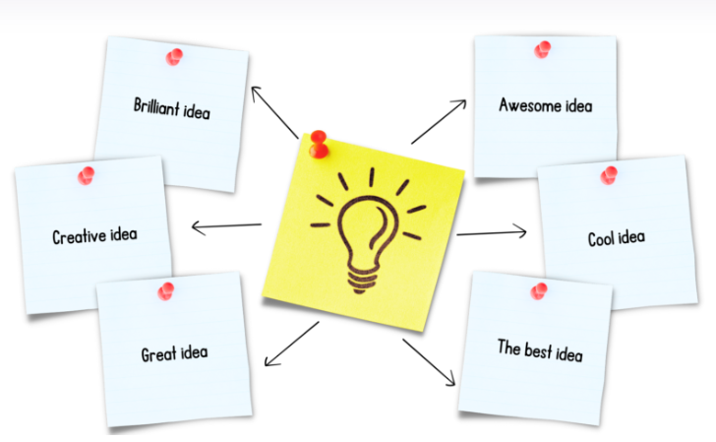
Requirement gathering technique 2/3
BRAINSTORMING
Team session held to generate and evaluate app ideas.

Slide 8
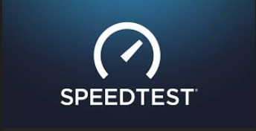


Requirement gathering technique 3/3
REVERSE ENGINEERING
Learning from existing apps like SpeedTest by Ookla, OpenSignal and nPerf.

Slide 9
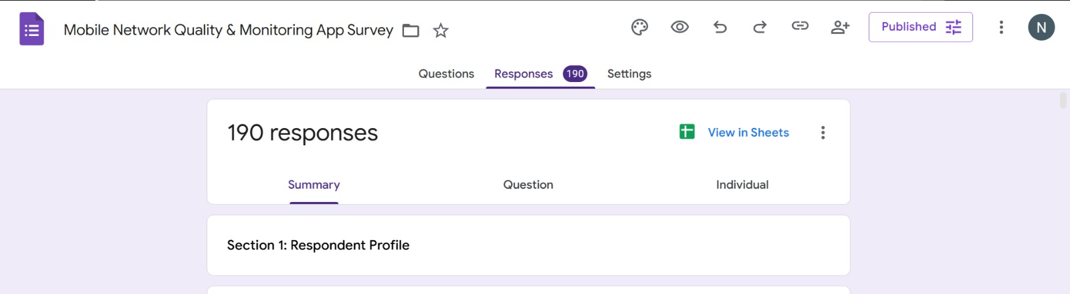
DAta GATHERING
04
Survey distributed via WhatsApp and Social media.
Targets: Mobile subscribers across multiple regions of Cameroon.
190 responses collected.
Open-ended questions allowed users to express additional thoughts.

Slide 10

DAta Cleaning 1/2
05
Why Cleaning is necessary?
Ensures data is accurate, complete, consistent and usable for analysis or decision-making.
Address common data quality issues such as duplicates, missing values, inconsistencies, syntax errors, irrelevant data and structural error,

Slide 11
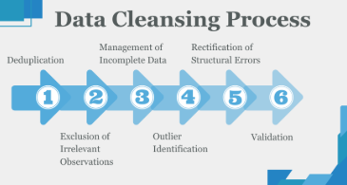
DAta Cleaning 2/2
Process of Cleaning our data
Structural Standardization
Renaming
Whitespace Removal
Geographic and Text Harmonization
City Name consolidation
Case correction
Accent Normalization
Neighborhood mapping
Data Integrity and Deduplication
Missing Value Management, etc

Slide 12
06
USER RELUCTANCE ASSESSMENT
A major challenge faced during this phase was low user participation and engagement in data collection activities.
Many users were unwilling to fill out the surveys.
Some participants ignored or abandoned surveys midway.
A few gave jokes or careless answers suggesting disengagement.
Privacy concerns made some users reluctant to provide their city or location.
Follow up of participants was required since some forgot to fill the form when shared.
Difficulty accessing IT professionals due to lack of permission or formal authorization.
Limited opportunities to conduct in-person interviews in professional environments.

Slide 13
Conclusion
07
Three requirement gathering techniques were used.
Real user data was collected from mobile subscribers
Data was cleaned to ensure accuracy and reliability
Requirements gathered form a solid foundation for the mobile app development phase.

Slide 14

Thank You

